Slide 1
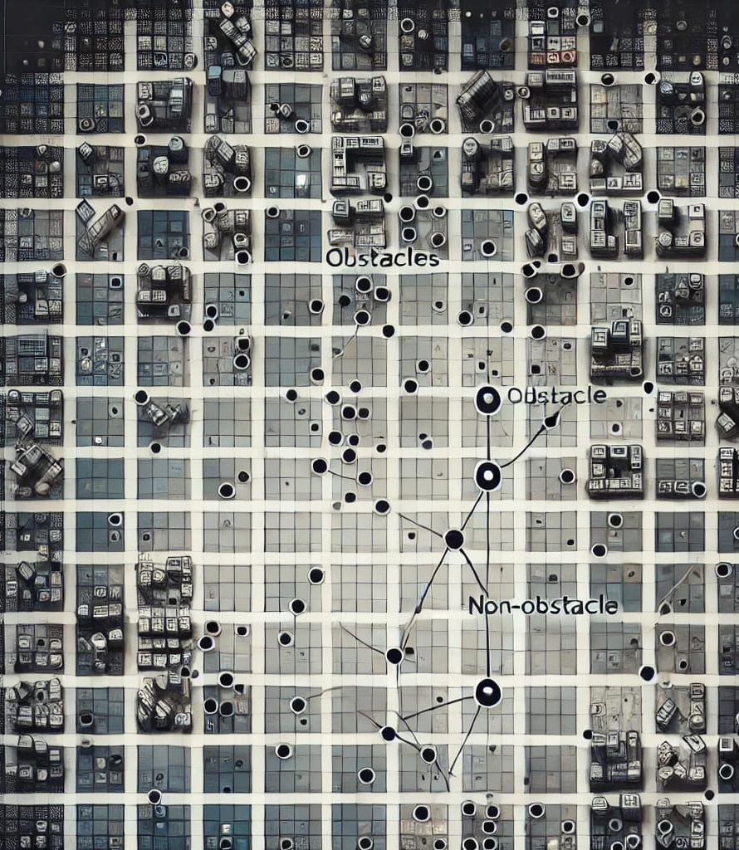
Visibility Learning

Slide 2
32x32 Obstacle encoding
Normalized Coordinates
0.782517 | 0.978248
0.844531 | 0.174709
Convolution layer input: 32x32
Fully connected layer input: Convolution output + coordinates

Slide 3
32x32 Obstacle encoding
Coordinate as second channel
 |  | 1
 |  |  |  |  |  | 1
Convolution layer input : 2x32x32

Slide 4
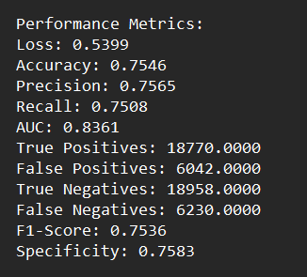
Performance Metrics using CNN model
Total Points (Training 80% + Validation 20%) : 150K
A total of 150K points were generated, with 50K points each from datasets with 10%, 20%, and 30% obstacles.
Independent Test set : 50K Points from 10% obstacle dataset

Slide 5
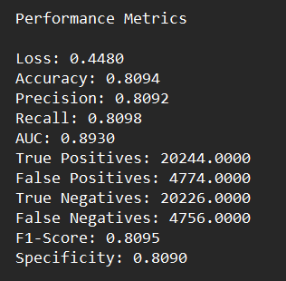
Performance Metrics using CNN model
Total Points (Training 80% + Validation 20%) : 150K
A total of 150K points were generated, with 50K points each from datasets with 10%, 20%, and 30% obstacles.
Independent Test set : 50K Points from 20% obstacle dataset

Slide 6
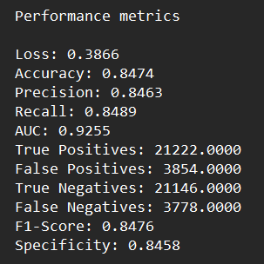
Performance Metrics using CNN model
Total Points (Training 80% + Validation 20%) : 150K
A total of 150K points were generated, with 50K points each from datasets with 10%, 20%, and 30% obstacles.
Independent Test set : 50K Points from 30% obstacle dataset

Slide 7
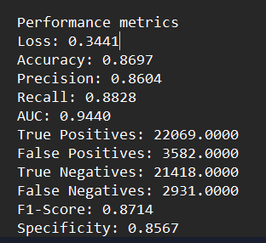
Performance Metrics using CNN model
Performance Metrics using CNN model
Total Points (Training 80% + Validation 20%) : 150K
Total Points (Training 80% + Validation 20%) : 150K
A total of 150K points were generated, with 50K points each from datasets with 10%, 20%, and 30% obstacles.
A total of 150K points were generated, with 50K points each from datasets with 10%, 20%, and 30% obstacles.
Independent Test set : 50K Points from 40% obstacle dataset

Slide 8
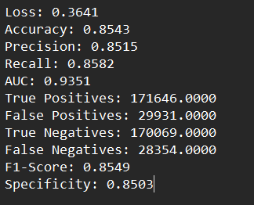
Performance Metrics using CNN model
Total Points (Training 80% + Validation 20%) : 240K
A total of 240K points were generated, with 60K points each from datasets with 10%, 20%, and 30% obstacles and 40% obstacles.
Independent Test set : 400K Points with 100K points each from 10%,20%,30%,40% obstacle datasets

Slide 9
10% Obstacle, Resolution: 32 x 32, Total Random Scenes: 1000
 | Points Per Scene
 | 50 | 100 | 150 | 200
Loss | 0.5804 | 0.5261 | 0.5179 | 0.5146
Accuracy | 0.7147 | 0.7492 | 0.7548 | 0.7553
Precision | 0.6486 | 0.7165 | 0.7438 | 0.7477
Recall | 0.6369 | 0.6171 | 0.5905 | 0.5861
AUC | 0.7678 | 0.8137 | 0.8204 | 0.8217
True Pos: | 2566.0000 | 49373.0000 | 47243.0000 | 46892.0000
False Pos: | 1390.0000 | 19538.0000 | 25829.0000 | 15819.0000
True Neg: | 4581.0000 | 100459.0000 | 94168.0000 | 104178.0000
False Neg: | 1463.0000 | 30630.0000 | 38089.0000 | 33111.0000
F1 Score: | 0.6427 | 0.6631 | 0.5674 | 0.6571
Specificity: | 0.7672 | 0.8372 | 0.7848 | 0.8682

Slide 10
10% Obstacle, Resolution: 32 x 32, Total Random Points per scene: 100
 | Total Random Scene
 | 500 | 1000 | 2500 | 5000
Loss | 0.5590 | 0.5261 | 0.5159 | 0.4983
Accuracy | 0.7291 | 0.7492 | 0.7552 | 0.7645
Precision | 0.7049 | 0.7165 | 0.7412 | 0.7461
Recall | 0.5552 | 0.6171 | 0.5962 | 0.6234
AUC | 0.7866 | 0.8137 | 0.8219 | 0.8328
True Pos: | 44416.0000 | 49373.0000 | 47698.0000 | 49870.0000
False Pos: | 18591.0000 | 19538.0000 | 16271.0000 | 16975.0000
True Neg: | 101406.0000 | 100459.0000 | 103726.0000 | 103022.0000
False Neg: | 35587.0000 | 30630.0000 | 32760.0000 | 30133.0000
F1 Score: | 0.6212 | 0.6631 | 0.6608 | 0.6792
Specificity: | 0.8451 | 0.8372 | 0.8612 | 0.8585

Slide 11
10% Obstacle, Resolution: 64 x 64, Total Random Scenes: 1000
 | Points Per Scene
 | 50 | 100 | 150 | 200
Loss | 0.5639 | 0.5460 | 0.5361 | 0.5133
Accuracy | 0.7250 | 0.7397 | 0.7463 | 0.7559
Precision | 0.6574 | 0.7162 | 0.7062 | 0.7421
Recall | 0.6527 | 0.5786 | 0.6262 | 0.5976
AUC | 0.7880 | 0.8004 | 0.8088 | 0.8218
True Pos: | 52215.0000 | 46288.0000 | 50099.0000 | 47811.0000
False Pos: | 27207.0000 | 18346.0000 | 20840.0000 | 16618.0000
True Neg: | 92790.0000 | 101651.0000 | 99157.0000 | 103379.0000
False Neg: | 27788.0000 | 33715.0000 | 29904.0000 | 32192.0000
F1 Score: | 0.6550 | 0.6401 | 0.6638 | 0.6621
Specificity: | 0.7733 | 0.8471 | 0.8263 | 0.8615

Slide 12
10% Obstacle, Resolution: 64 x 64, Total Random Points per scene: 100
 | Total Random Scene
 | 500 | 1000 | 2500 | 5000
Loss | 0.5836 | 0.5460 | 0.5256 | 0.5123
Accuracy | 0.7137 | 0.7397 | 0.7533 | 0.7590
Precision | 0.6514 | 0.7162 | 0.7346 | 0.7336
Recall | 0.6116 | 0.5786 | 0.6003 | 0.6240
AUC | 0.7697 | 0.8004 | 0.8178 | 0.8258
True Pos: | 48928.0000 | 46288.0000 | 48026.0000 | 49921.0000
False Pos: | 26183.0000 | 18346.0000 | 17354.0000 | 18126.0000
True Neg: | 93814.0000 | 101651.0000 | 102643.0000 | 101871.0000
False Neg: | 31075.0000 | 33715.0000 | 31977.0000 | 30082.0000
F1 Score: | 0.6309 | 0.6401 | 0.6607 | 0.6744
Specificity: | 0.7818 | 0.8471 | 0.8554 | 0.8489

Slide 13
10% Obstacle, Resolution: 128 x 128, Total Random Scenes: 1000
 | Points Per Scene
 | 50 | 100 | 150 | 200
Loss | 0.6079 | 0.5797 | 0.5694 | 0.5602
Accuracy | 0.6927 | 0.7235 | 0.7291 | 0.7315
Precision | 0.6521 | 0.6802 | 0.6990 | 0.6939
Recall | 0.4967 | 0.5827 | 0.5668 | 0.5883
AUC | 0.7363 | 0.7749 | 0.7824 | 0.7880
True Pos: | 39732.0000 | 46613.0000 | 45344.0000 | 47063.0000
False Pos: | 21197.0000 | 21919.0000 | 19527.0000 | 20760.0000
True Neg: | 98803.0000 | 98081.0000 | 100473.0000 | 99240.0000
False Neg: | 40268.0000 | 33387.0000 | 34656.0000 | 32937.0000
F1 Score: | 0.5639 | 0.6276 | 0.6260 | 0.6367
Specificity: | 0.7660 | 0.8173 | 0.8373 | 0.8270

Slide 14
10% Obstacle, Resolution: 128 x 128, Total Random Points per scene: 100
 | Total Random Scene
 | 500 | 100 | 2500 | 5000
Loss | 0.6032 | 0.5797 | 0.5647 | 0.5041
Accuracy | 0.7141 | 0.7235 | 0.7365 | 0.7612
Precision | 0.6661 | 0.6802 | 0.7115 | 0.7510
Recall | 0.5717 | 0.5827 | 0.5742 | 0.6029
AUC | 0.7619 | 0.7749 | 0.7940 | 0.8282
True Pos: | 45740.0000 | 46613.0000 | 45933.0000 | 48231.0000
False Pos: | 22926.0000 | 21919.0000 | 18629.0000 | 15990.0000
True Neg: | 97074.0000 | 98081.0000 | 102643.0000 | 101871.0000
False Neg: | 34260.0000 | 33387.0000 | 34067.0000 | 104010.0000
F1 Score: | 0.6153 | 0.6276 | 0.6355 | 0.6688
Specificity: | 0.8089 | 0.8173 | 0.8448 | 0.864

Slide 15
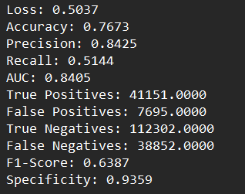
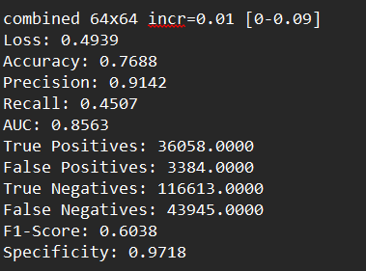
Combined Training dataset
Varied obstacle percentage from 0% to 9%
Generated a total of 200 random scene for each obstacle percentage
Each scene has 100 pair of query points
32 x 32 encoding & 64x64 encoding, Test set contains 2000 random scene with 10% obstacle and 100 pair of query points from each scene

Slide 16
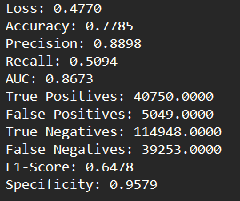
Combined Training dataset
Varied obstacle percentage from 0% to 9%
Generated a total of 1000 random scene for each obstacle percentage
Each scene has 100 pair of query points
64x64 encoding, Test set contains 2000 random scene with 10% obstacle and 100 pair of query points from each scene

Slide 17
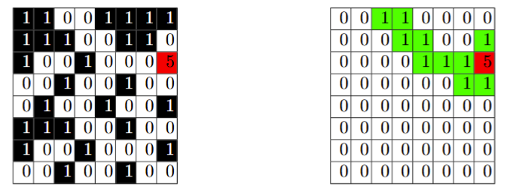
New approach – Visibility MAP WITH RESPECt to a point
Input: Obstacle encoding of the whole scene with a query point
Output: Visibility mapping of the whole scene with respect to that point
Input
Output

Slide 18
New approach
Total Random Scene 5000, 10 points per scene
 | Resolution
 | 32 x 32 | 64 x 64
Loss | 0.2039 | 0.1523
Accuracy | 0.8924 | 0.9337
Precision | 0.8961 | 0.9439
Recall | 0.7602 | 0.8456
AUC | 0.9375 | 0.9770
True Pos: | 25320382.0000 | 111833400.0000
False Pos: | 2935394.0000 | 6651272.0000
True Neg: | 66156380.0000 | 270691296.0000
False Neg: | 7987887.0000 | 20424094.0000
F1 Score: | 0.8226 | 0.8920
Specificity: | 0.9575 | 0.9760

Slide 19
New approach
Total Random Scene 2000, 10 points per scene
 | Resolution
 | 128 x 128
Loss | 0.3337
Accuracy | 0.8616
Precision | 0.9383
Recall | 0.6113
AUC | 0.8911
True Pos: | 64604916.0000
False Pos: | 4245369.0000
True Neg: | 217742400.0000
False Neg: | 41087380.0000
F1 Score: | 0.7403
Specificity: | 0.9809

Slide 20
New approach
Total Random Scene 30000
 | Resolution
 | 32 x 32
Loss | 0.1211
Accuracy | 0.9547
Precision | 0.9751
Recall | 0.8870
AUC | 0.9858
True Pos: | 6061065.0000
False Pos: | 155006.0000
True Neg: | 13491805.0000
False Neg: | 772124.0000
F1 Score: | 0.9290
Specificity: | 0.9886

Slide 21
Combined Training SET
Varied obstacle percentage from 0% to 50%
Each obstacle percentage contains 2000 random scene
From each scene we took 500 pair of points
For obs_percentage [5%-20%] we took 250 random pair points and 250 points near obstacle
Test set: 2000 random scene, 200 pair of query points for a particular obstacle percentage

Slide 22
How we generated point around a obstacle
Thus we generated a total of 50 pair of points
Per obstacle

Slide 23
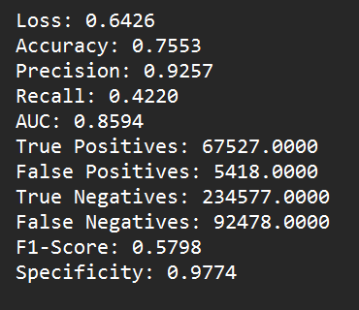
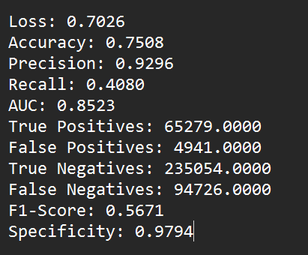
Test set:10% obstacle percentage
Train set: obstacle percentage increase 5%
Train set: obstacle percentage increase 10%

Slide 24
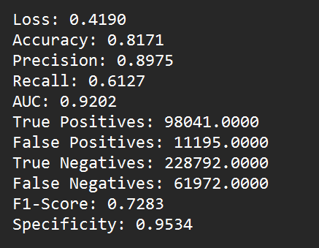
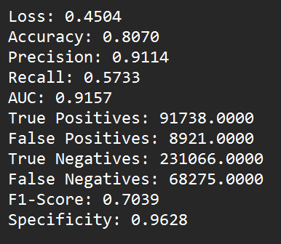
Test set:30% obstacle percentage
Train set: obstacle percentage increase 5%
Train set: obstacle percentage increase 10%

Slide 25
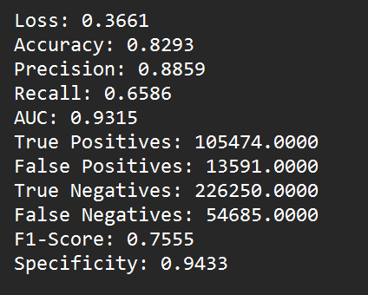
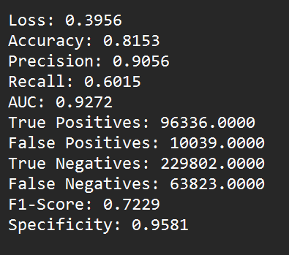
Test set:50% obstacle percentage
Train set: obstacle percentage increase 5%
Train set: obstacle percentage increase 10%

Slide 26
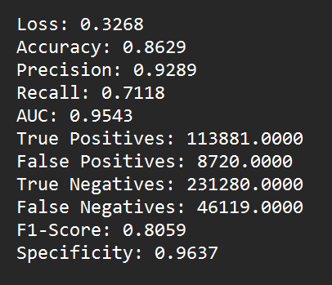
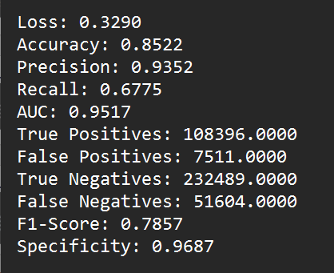
Test set:70% obstacle percentage
Train set: obstacle percentage increase 5%
Train set: obstacle percentage increase 10%

Slide 27
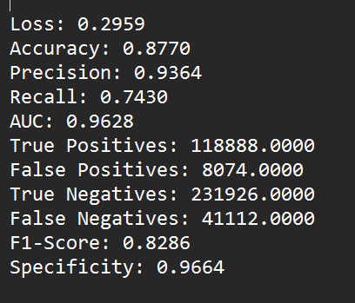
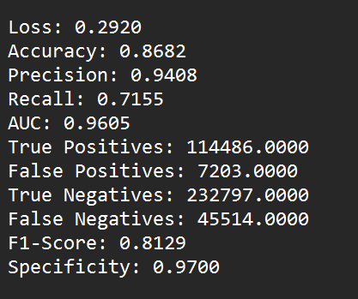
Test set:90% obstacle percentage
Train set: obstacle percentage increase 5%
Train set: obstacle percentage increase 10%

Slide 28
Combined Training SET
Varied obstacle percentage from 0% to 50%
Each obstacle percentage contains 2000 random scene
From each scene we took 500 pair of points
Test set: 2000 random scene, 200 pair of query points per scene

Slide 29
Test set:10% obstacle percentage
Train set: obstacle percentage increase 5%
Train set: obstacle percentage increase 10%
 | Resolution 32x32
Loss | 0.3875
Accuracy | 0.8211
Precision | 0.8071
Recall | 0.7265
AUC | 0.8972
True Pos: | 116246.0000
False Pos: | 27785.0000
True Neg: | 212210.0000
False Neg: | 43759.0000
F1 Score: | 0.7647
Specificity: | 0.8842
 | Resolution 32x32
Loss | 0.4040
Accuracy | 0.8134
Precision | 0.8057
Recall | 0.7029
AUC | 0.8885
True Pos: | 112474.0000
False Pos: | 27124.0000
True Neg: | 212871.0000
False Neg: | 47531.0000
F1 Score: | 0.7508
Specificity: | 0.8870

Slide 30
Test set:30% obstacle percentage
Train set: obstacle percentage increase 5%
Train set: obstacle percentage increase 10%
 | Resolution 32x32
Loss | 0.2762
Accuracy | 0.8765
Precision | 0.8376
Recall | 0.8576
AUC | 0.9513
True Pos: | 137226.0000
False Pos: | 26598.0000
True Neg: | 213389.0000
False Neg: | 22787.0000
F1 Score: | 0.8475
Specificity: | 0.8892
 | Resolution 32x32
Loss | 0.2835
Accuracy | 0.8741
Precision | 0.8282
Recall | 0.8647
AUC | 0.9493
True Pos: | 138358.0000
False Pos: | 138358.0000
True Neg: | 28696.0000
False Neg: | 21655.0000
F1 Score: | 0.8461
Specificity: | 0.8804

Slide 31
Test set:50% obstacle percentage
Train set: obstacle percentage increase 5%
Train set: obstacle percentage increase 10%
 | Resolution 32x32
Loss | 0.2535
Accuracy | 0.8861
Precision | 0.8287
Recall | 0.9019
AUC | 0.9601
True Pos: | 144443.0000
False Pos: | 29860.0000
True Neg: | 209981.0000
False Neg: | 15716.0000
F1 Score: | 0.8637
Specificity: | 0.8755
 | Resolution 32x32
Loss | 0.2615
Accuracy | 0.8840
Precision | 0.8175
Recall | 0.9145
AUC | 0.9597
True Pos: | 146458.0000
False Pos: | 32703.0000
True Neg: | 207138.0000
False Neg: | 13701.0000
F1 Score: | 0.8632
Specificity: | 0.8636

Slide 32
Test set:70% obstacle percentage
Train set: obstacle percentage increase 5%
Train set: obstacle percentage increase 10%
 | Resolution 32x32
Loss | 0.1971
Accuracy | 0.9148
Precision | 0.8932
Recall | 0.8938
AUC | 0.9754
True Pos: | 143015.0000
False Pos: | 17096.0000
True Neg: | 222904.0000
False Neg: | 16985.0000
F1 Score: | 0.8935
Specificity: | 0.9288
 | Resolution 32x32
Loss | 0.2015
Accuracy | 0.9135
Precision | 0.8787
Recall | 0.9094
AUC | 0.9747
True Pos: | 145498.0000
False Pos: | 20080.0000
True Neg: | 219920.0000
False Neg: | 14502.0000
F1 Score: | 0.8938
Specificity: | 0.9163

Slide 33
Test set:90% obstacle percentage
Train set: obstacle percentage increase 5%
Train set: obstacle percentage increase 10%
 | Resolution 32x32
Loss | 0.1782
Accuracy | 0.9231
Precision | 0.9015
Recall | 0.9069
AUC | 0.9799
True Pos: | 145108.0000
False Pos: | 15849.0000
True Neg: | 224151.0000
False Neg: | 14892.0000
F1 Score: | 0.9042
Specificity: | 0.9340
 | Resolution 32x32
Loss | 0.1818
Accuracy | 0.9227
Precision | 0.8892
Recall | 0.9216
AUC | 0.9795
True Pos: | 147464.0000
False Pos: | 18375.0000
True Neg: | 221625.0000
False Neg: | 12536.0000
F1 Score: | 0.9051
Specificity: | 0.9234

Slide 34
Combined Training SET
Varied obstacle percentage from 0% to 50%
Each obstacle percentage contains 2000 random scene
From each scene we took 1500 pair of points (randomly)
Test set: 2000 random scene, 200 pair of query points per scene

Slide 35
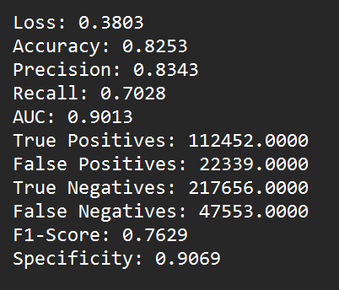
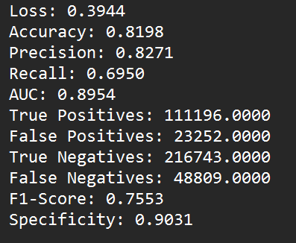
Test set:10% obstacle percentage
Train set: obstacle percentage increase 5%
Train set: obstacle percentage increase 10%

Slide 36
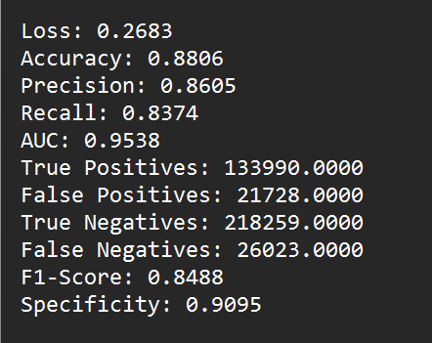
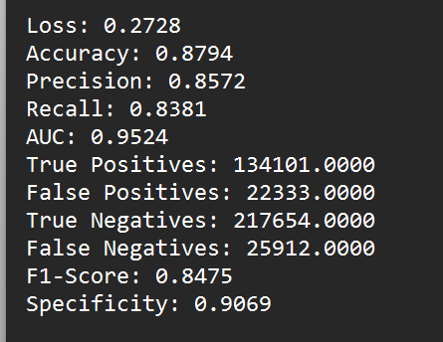
Test set:30% obstacle percentage
Train set: obstacle percentage increase 5%
Train set: obstacle percentage increase 10%

Slide 37
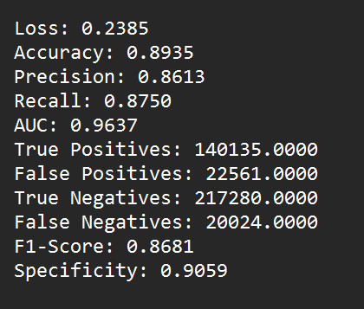
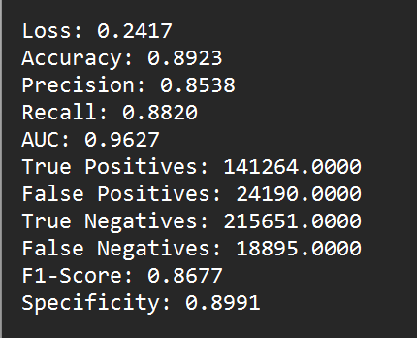
Test set:50% obstacle percentage
Train set: obstacle percentage increase 5%
Train set: obstacle percentage increase 10%

Slide 38
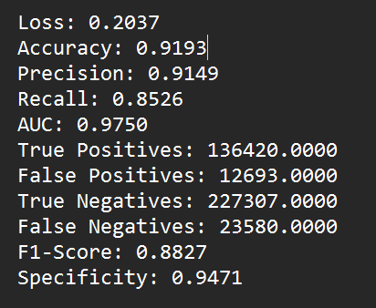
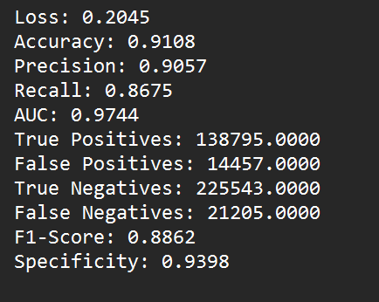
Test set:70% obstacle percentage
Train set: obstacle percentage increase 5%
Train set: obstacle percentage increase 10%

Slide 39
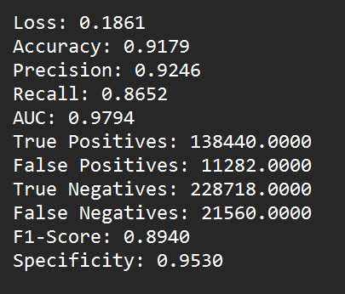
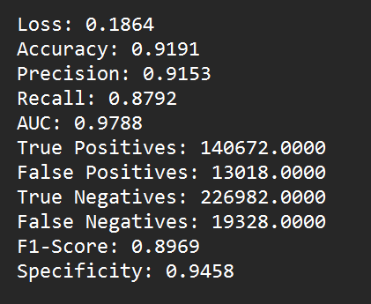
Test set:90% obstacle percentage
Train set: obstacle percentage increase 5%
Train set: obstacle percentage increase 10%

Slide 40
Performance metrics with varying threshold
Combined training set. Obs percentage 0% to 50% increased by 10%.
Each obs percentage contains 2000 scene and each scene contains 500 pair of query points.
Each test set contains 2000 random scene with 200 pair of query points

Slide 41
Test set: 10% obstacles
 | Threshold = 0.5 | Threshold = 0.4 | Threshold = 0.3 | Threshold = 0.6 | Threshold = 0.7
Loss | 0.4040 | 0.4040 | 0.4040 | 0.4040 | 0.4040
Accuracy | 0.8134 | 0.79678 | 0.77661 | 0.8005 | 0.79031
Precision | 0.8057 | 0.751532 | 0.686054 | 0.8031 | 0.86084
Recall | 0.7029 | 0.73495 | 0.814080 | 0.66439 | 0.56755
AUC | 0.8885 | 0.8885 | 0.8885 | 0.8885 | 0.8885
True Pos: | 112474.0000 | 117596 | 130257 | 106306 | 90812
False Pos: | 27124.0000 | 38879 | 59607 | 26062 | 14680
True Neg: | 212871.0000 | 201116 | 180388 | 213933 | 225315
False Neg: | 47531.0000 | 42409 | 29748 | 53699 | 69193
F1 Score: | 0.7508 | 0.743149 | 0.74460 | 0.72719 | 0.68409
Specificity: | 0.8870 | 0.83800 | 0.75163 | 0.8914 | 0.93883

Slide 42
Test set: 20% obstacles
 | Threshold = 0.5 | Threshold = 0.4 | Threshold = 0.3 | Threshold = 0.6 | Threshold = 0.7
Loss | 0.3295 | 0.3295 | 0.3295 | 0.3295 | 0.3295
Accuracy | 0.8460 | 0.84151 | 0.82520 | 0.84746 | 0.84268
Precision | 0.8234 | 0.78188 | 0.73293 | 0.822250 | 0.86848
Recall | 0.7830 | 0.83737 | 0.88575 | 0.789288 | 0.71498
AUC | 0.9232 | 0.9232 | 0.9232 | 0.9232 | 0.9232
True Pos: | 125277 | 133981 | 141721 | 126287 | 114399
False Pos: | 26868 | 37376 | 51639 | 27300 | 17323
True Neg: | 213131 | 202623 | 188360 | 212699 | 222676
False Neg: | 34724 | 26020 | 18280 | 33714 | 45602
F1 Score: | 0.8027 | 0.80867 | 0.80213 | 0.805432 | 0.78429
Specificity: | 0.8880 | 0.84426 | 0.78483 | 0.88624 | 0.92782

Slide 43
Test set: 30% obstacles
 | Threshold = 0.5 | Threshold = 0.4 | Threshold = 0.3 | Threshold = 0.6 | Threshold = 0.7
Loss | 0.2835 | 0.2835 | 0.2835 | 0.2835 | 0.2835
Accuracy | 0.8741 | 0.86123 | 0.84681 | 0.86798 | 0.8668
Precision | 0.8282 | 0.792348 | 0.752724 | 0.82531 | 0.86517
Recall | 0.8647 | 0.885065 | 0.91893 | 0.84988 | 0.7904
AUC | 0.9493 | 0.9493 | 0.9493 | 0.9493 | 0.9493
True Pos: | 138358.0000 | 141622 | 147041 | 135993 | 126477
False Pos: | 138358.0000 | 37115 | 48304 | 28785 | 19710
True Neg: | 28696.0000 | 202872 | 191683 | 211202 | 220277
False Neg: | 21655.0000 | 18391 | 12972 | 24020 | 33536
F1 Score: | 0.8461 | 0.836144 | 0.82756 | 0.83741 | 0.82610
Specificity: | 0.8804 | 0.84534 | 0.79872 | 0.88005 | 0.91787

Slide 44
Test set: 40% obstacles
 | Threshold = 0.5 | Threshold = 0.4 | Threshold = 0.3 | Threshold = 0.6 | Threshold = 0.7
Loss | 0.2938 | 0.2938 | 0.2938 | 0.2938 | 0.2938
Accuracy | 0.8704 | 0.8558 | 0.8343 | 0.87873 | 0.84268
Precision | 0.7900 | 0.75531 | 0.71803 | 0.824204 | 0.86848
Recall | 0.9205 | 0.94601 | 0.96457 | 0.88579 | 0.714989
AUC | 0.9537 | 0.9537 | 0.9537 | 0.9537 | 0.9537
True Pos: | 147306 | 151381 | 154351 | 141745 | 114399
False Pos: | 39146 | 49041 | 60613 | 30233 | 17323
True Neg: | 200834 | 190939 | 179367 | 209747 | 222676
False Neg: | 12714 | 8639 | 5669 | 18275 | 45602
F1 Score: | 0.8503 | 0.83997 | 0.82324 | 0.8538 | 0.784298
Specificity: | 0.8369 | 0.79564 | 0.7474 | 0.87401 | 0.92782

Slide 45
Test set: 50% obstacles
 | Threshold = 0.5 | Threshold = 0.4 | Threshold = 0.3 | Threshold = 0.6 | Threshold = 0.7
Loss | 0.2615 | 0.2615 | 0.2615 | 0.2615 | 0.2615
Accuracy | 0.8840 | 0.874155 | 0.86078 | 0.88149 | 0.88459
Precision | 0.8175 | 0.79248 | 0.76093 | 0.817214 | 0.85137
Recall | 0.9145 | 0.92894 | 0.95111 | 0.906855 | 0.86229
AUC | 0.9597 | 0.9597 | 0.9597 | 0.9597 | 0.9597
True Pos: | 146458.0000 | 148779 | 152330 | 145241 | 138105
False Pos: | 32703.0000 | 38958 | 47857 | 32486 | 24110
True Neg: | 207138.0000 | 200883 | 191984 | 207355 | 215731
False Neg: | 13701.0000 | 11380 | 7829 | 14918 | 22054
F1 Score: | 0.8632 | 0.85530 | 0.845465 | 0.85970 | 0.85679
Specificity: | 0.8636 | 0.83756 | 0.80046 | 0.86455 | 0.89947

Slide 46
Test set: 60% obstacles
 | Threshold = 0.5 | Threshold = 0.4 | Threshold = 0.3 | Threshold = 0.6 | Threshold = 0.7
Loss | 0.2957 | 0.2957 | 0.2957 | 0.2957 | 0.2957
Accuracy | 0.8697 | 0.8539 | 0.833055 | 0.88074 | 0.88508
Precision | 0.7779 | 0.74611 | 0.71297 | 0.80974 | 0.8430
Recall | 0.9444 | 0.96323 | 0.97629 | 0.91800 | 0.87621
AUC | 0.9575 | 0.9575 | 0.9575 | 0.9575 | 0.9575
True Pos: | 151341 | 154354 | 156447 | 147106 | 140409
False Pos: | 43217 | 52523 | 62980 | 34564 | 26132
True Neg: | 196538 | 187232 | 176775 | 205191 | 213623
False Neg: | 8904 | 5891 | 3798 | 13139 | 19836
F1 Score: | 0.8531 | 0.84088 | 0.824116 | 0.86048 | 0.859333
Specificity: | 0.8197 | 0.7809 | 0.73731 | 0.85583 | 0.89100

Slide 47
Test set: 70% obstacles
 | Threshold = 0.5 | Threshold = 0.4 | Threshold = 0.3 | Threshold = 0.6 | Threshold = 0.7
Loss | 0.2015 | 0.2015 | 0.2015 | 0.2015 | 0.2015
Accuracy | 0.9135 | 0.90980 | 0.903357 | 0.91254 | 0.88459
Precision | 0.8787 | 0.86244 | 0.835474 | 0.88134 | 0.851370
Recall | 0.9094 | 0.92147 | 0.94436 | 0.9029 | 0.86229
AUC | 0.9747 | 0.9747 | 0.9747 | 0.9747 | 0.9747
True Pos: | 145498.0000 | 147436 | 151098 | 144466 | 138105
False Pos: | 20080.0000 | 23515 | 29755 | 19449 | 24110
True Neg: | 219920.0000 | 216485 | 210245 | 220551 | 215731
False Neg: | 14502.0000 | 12564 | 8902 | 15534 | 22054
F1 Score: | 0.8938 | 0.89098 | 0.88658 | 0.89199 | 0.85679
Specificity: | 0.9163 | 0.90202 | 0.87602 | 0.9189 | 0.89947

Slide 48
Test set: 80% obstacles
 | Threshold = 0.5 | Threshold = 0.4 | Threshold = 0.3 | Threshold = 0.6 | Threshold = 0.7
Loss | 0.2039 | 0.2039 | 0.2039 | 0.2039 | 0.2039
Accuracy | 0.9149 | 0.9067 | 0.892955 | 0.91803 | 0.91543
Precision | 0.8619 | 0.8337 | 0.80179 | 0.88789 | 0.9131
Recall | 0.9375 | 0.95782 | 0.97289 | 0.909987 | 0.8714
AUC | 0.9769 | 0.9769 | 0.9769 | 0.9769 | 0.9769
True Pos: | 150005 | 153252 | 155663 | 145598 | 139428
False Pos: | 24037 | 30569 | 38481 | 18383 | 13253
True Neg: | 215963 | 209431 | 201519 | 221617 | 226747
False Neg: | 9995 | 6748 | 4337 | 14402 | 20572
F1 Score: | 0.8981 | 0.89146 | 0.87909 | 0.89880 | 0.89182
Specificity: | 0.8998 | 0.87263 | 0.83966 | 0.92340 | 0.94477

Slide 49
Test set: 90% obstacles
 | Threshold = 0.5 | Threshold = 0.4 | Threshold = 0.3 | Threshold = 0.6 | Threshold = 0.7
Loss | 0.1818 | 0.1818 | 0.1818 | 0.1818 | 0.1818
Accuracy | 0.9227 | 0.91952 | 0.91432 | 0.9223 | 0.91945
Precision | 0.8892 | 0.87608 | 0.85187 | 0.89372 | 0.91755
Recall | 0.9216 | 0.93042 | 0.95118 | 0.91436 | 0.87746
AUC | 0.9795 | 0.9795 | 0.9795 | 0.9795 | 0.9795
True Pos: | 147464.0000 | 148868 | 152190 | 146298 | 140394
False Pos: | 18375.0000 | 21057 | 26462 | 17396 | 12615
True Neg: | 221625.0000 | 218943 | 213538 | 222604 | 227385
False Neg: | 12536.0000 | 11132 | 7810 | 13702 | 19606
F1 Score: | 0.9051 | 0.90243 | 0.89879 | 0.90392 | 0.89706
Specificity: | 0.9234 | 0.91226 | 0.88974 | 0.92751 | 0.94743

Slide 50
[Corrected] Combined Training SET
Corrected dataset generation process
The combined training set contains obstacle percentage from 0% to 50% increasing with 10%
Each obstacle percentage contains 2000 random scenes and each scene contains 500 pair of query points.
The ratio of positive and negative sample is each scene (except the 0% obstacle percentage) is equal. That means 50% positive sample and 50% negative sample
While testing we used individual obstacle percentage as test set. Each test set contains 2000 random scenes and each scene contains 200 pair of random query points

Slide 51
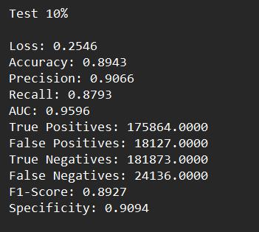
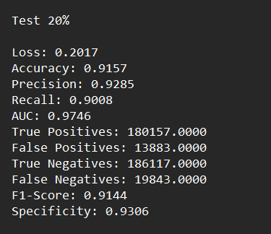
[Corrected] Combined Training SET

Slide 52
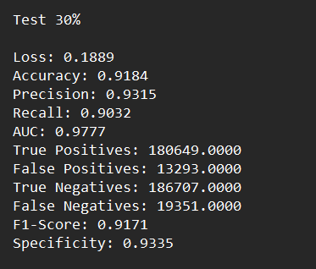
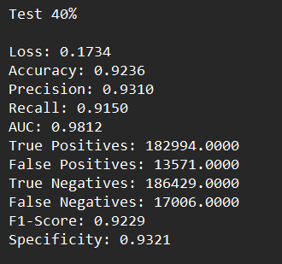
[Corrected] Combined Training SET

Slide 53
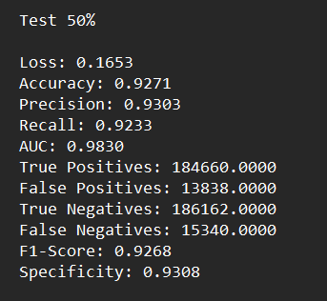
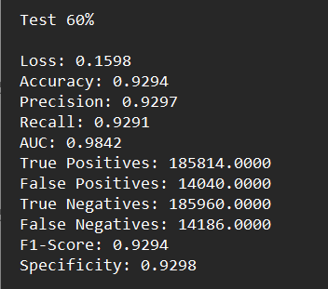
[Corrected] Combined Training SET

Slide 54
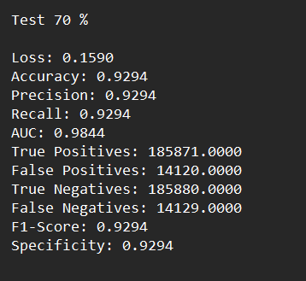
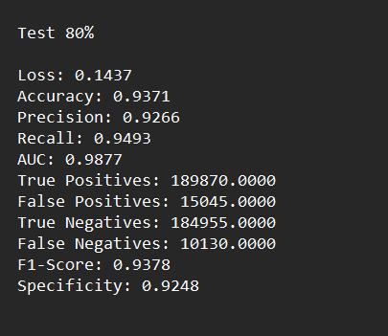
[Corrected] Combined Training SET

Slide 55
Experiment with 3D
32x32 Obstacle encoding
Coordinate as second channel
4 | 4 | 4 | 0 | 0 | 0 | 5 | 5
4 | 4 | 4 | 0 | 0 | 0 | 5 | 5
0 | 7 | 7 | 7 | 7 | 1 | 1 | 0
0 | 7 | 7 | 7 | 7 | 1 | 1 | 0
0 | 2 | 2 | 2 | 0 | 0 | 0 | 0
0 | 2 | 2 | 2 | 0 | 0 | 0 | 0
0 | 0 | 0 | 0 | 4 | 4 | 0 | 0
0 | 0 | 0 | 0 | 4 | 4 | 0 | 0
 |  | 9
 |  |  |  |  |  | 2
Convolution layer input : 2x32x32

Slide 56
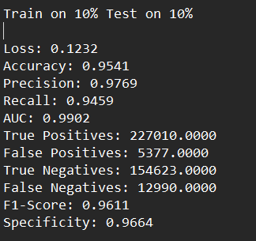
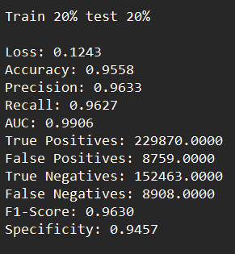
Total Training scene: 2000,
Test Scene: 2000,
Each training scene contains 500 pair of points whereas each test scene contains 200 pair of points

Slide 57
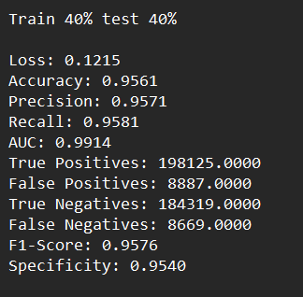
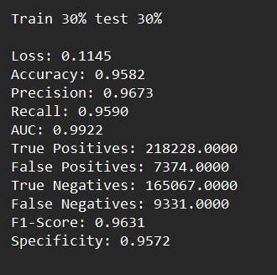
Total Training scene: 2000,
Test Scene: 2000,
Each training scene contains 500 pair of points whereas each test scene contains 200 pair of points

Slide 58
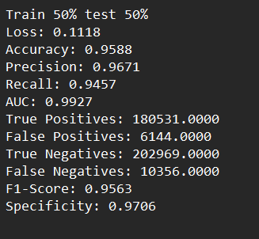
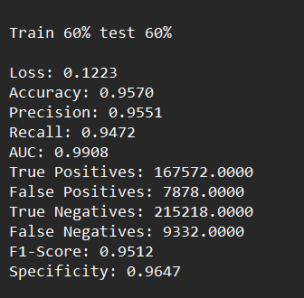
Total Training scene: 2000,
Test Scene: 2000,
Each training scene contains 500 pair of points whereas each test scene contains 200 pair of points

Slide 59
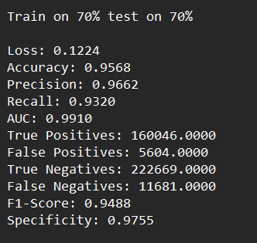
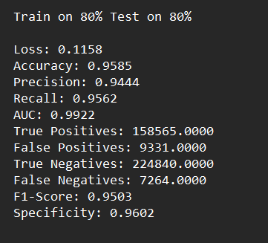
Total Training scene: 2000,
Test Scene: 2000,
Each training scene contains 500 pair of points whereas each test scene contains 200 pair of points

Slide 60
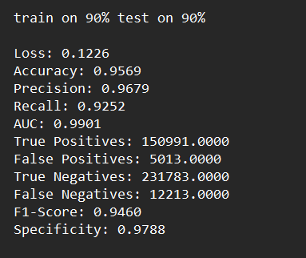
Total Training scene: 2000,
Test Scene: 2000,
Each training scene contains 500 pair of points whereas each test scene contains 200 pair of points

Slide 61
Dataset GENERATION REVISED
Now while generating points , if two query points lie in the same obstacle we have made them invisible to each other.
This might make the obstacles to feel rigid.
This approach improved the performance metrics
Training set – Combined training set (0 – 50%) obstacle percentage. Each percentage have 2000 scene and each scene has 500 query of points.
Total Points generated during training = 2000 * 500 * 6

Slide 62
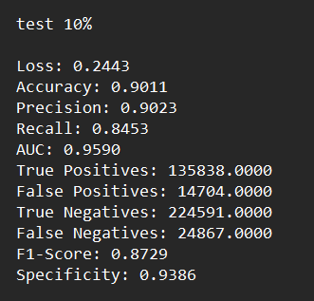
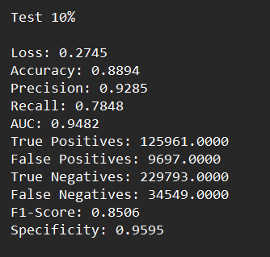
32 x 32 Encoding
64 x 64 Encoding

Slide 63
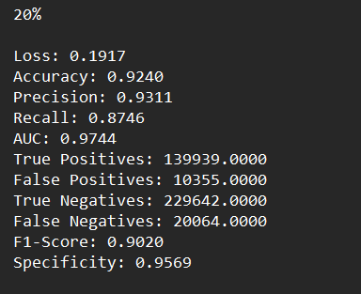

32 x 32 Encoding
64 x 64 Encoding

Slide 64


32 x 32 Encoding
64 x 64 Encoding

Slide 65


32 x 32 Encoding
64 x 64 Encoding

Slide 66


32 x 32 Encoding
64 x 64 Encoding

Slide 67


32 x 32 Encoding
64 x 64 Encoding

Slide 68


32 x 32 Encoding
64 x 64 Encoding

Slide 69


32 x 32 Encoding
64 x 64 Encoding

